Slide 1
“
Matrix Factorization & LLM Compression
”
Pingwei Sun
2023.9
BDT Program
HKUST

Slide 2
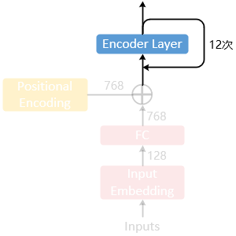
CPU设计
ALBERT
Methods
Since the vocabulary of BERT is 30,000, it is consuming to store the embedding layer as O(V x H). A fully connected layer is added after it to achieve O(V x E + E x H).
Pros
Untying the word embedding size E from the hidden layer size H.
23M = 30,000 x 768 => 30,000 x 128 + 128 x 768 = 4M
Cons
Only available in embedding layers. Refine-tuning is required.
Experiment
Compression ratio: 10%+ reduction in parameters of BERT series.
Performance: No ablation experiment.
ALBERT: A Lite BERT for Self-supervised Learning of Language Representations (2020 ICLR)

Slide 3
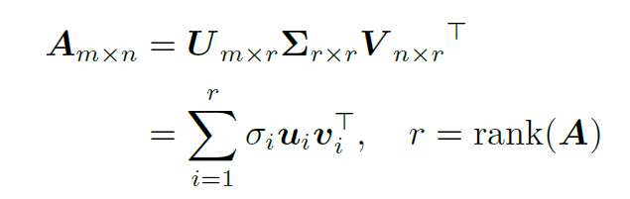
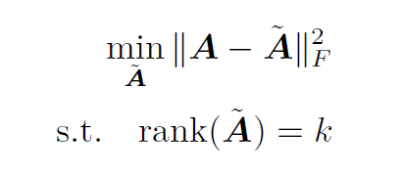
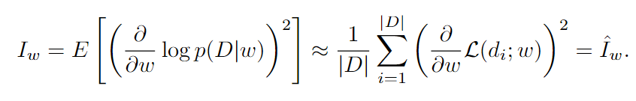

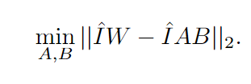
CPU设计
FWSVD
Methods
Matrices can be factorized by SVD. To reduce the size, we can select k < r for approximation.
Use Fisher information to measure the weights importance.
Pros
Align the optimization objective of compression with the model, rather than just minimizing reconstruction error (Frobenius norm).
Cons
Task specific, matrix I_{w} highly depends on the downstream dataset D.
Assuming parameters within each row share the same importance value.
Refine-tuning is required.
Experiment
Compression ratio: 40% (only applied on transformer blocks).
Performance: 70% w/o fine-tuning; 97% w/ fine-tuning.
Vanilla SVD
Fisher-Weighted SVD
Language model compression with weighted low-rank factorization (2022 ICLR)

Slide 4
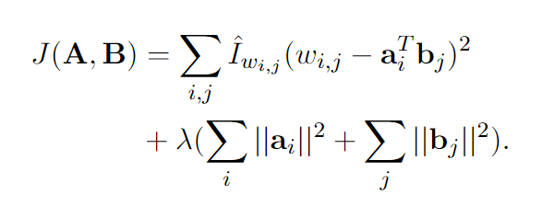
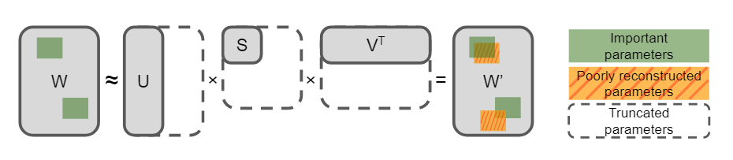
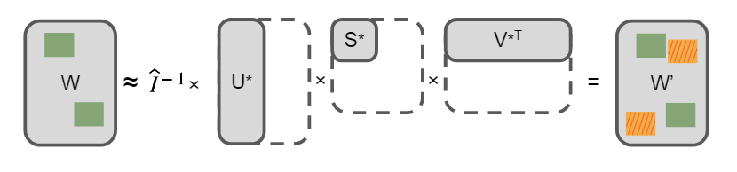
CPU设计
TFWSVD
Methods
Improve the accurate usage of Fisher information in FWSVD.
Solution of J is obtained with Alternating Least Squares.
Pros
Element-wise Fisher information instead of sharing importance value in one row.
L2 regularization terms can be added to avoid over fitting.
Cons
More training steps, 1.5x of FWSVD.
Experiment
Compression ratio: 40% (only applied on transformer blocks).
Performance: 80% w/o fine-tuning; 99% w/ fine-tuning.
Vanilla SVD
Fisher-Weighted SVD
Numerical Optimizations for Weighted Low-rank Estimation on Language Model (ACL 2022)

Slide 5
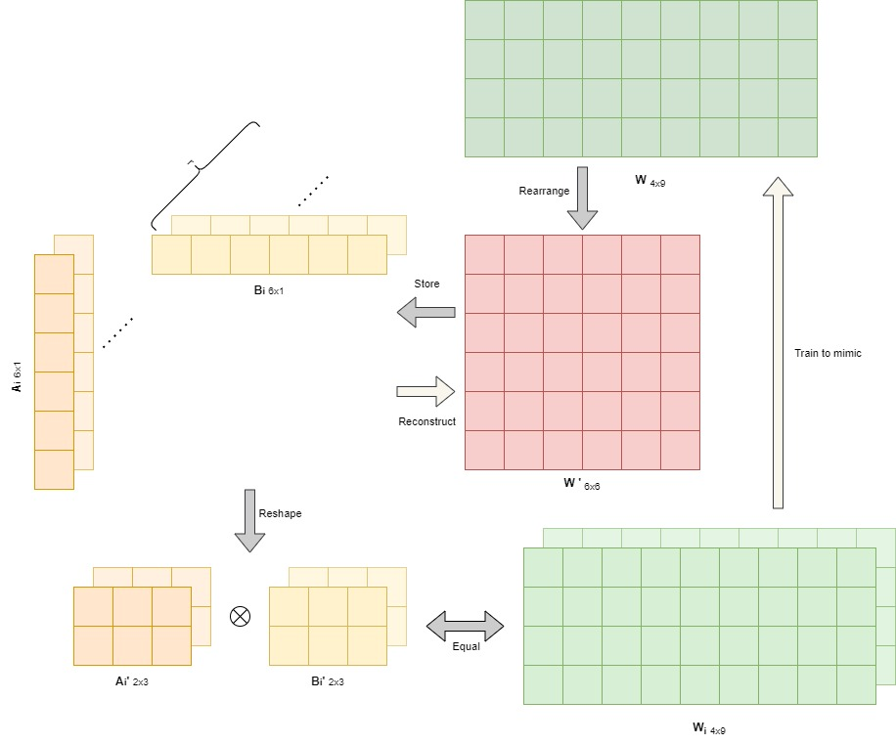
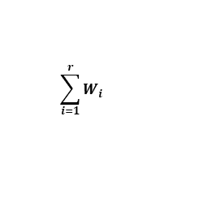
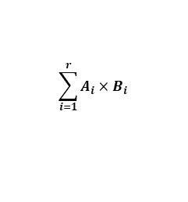
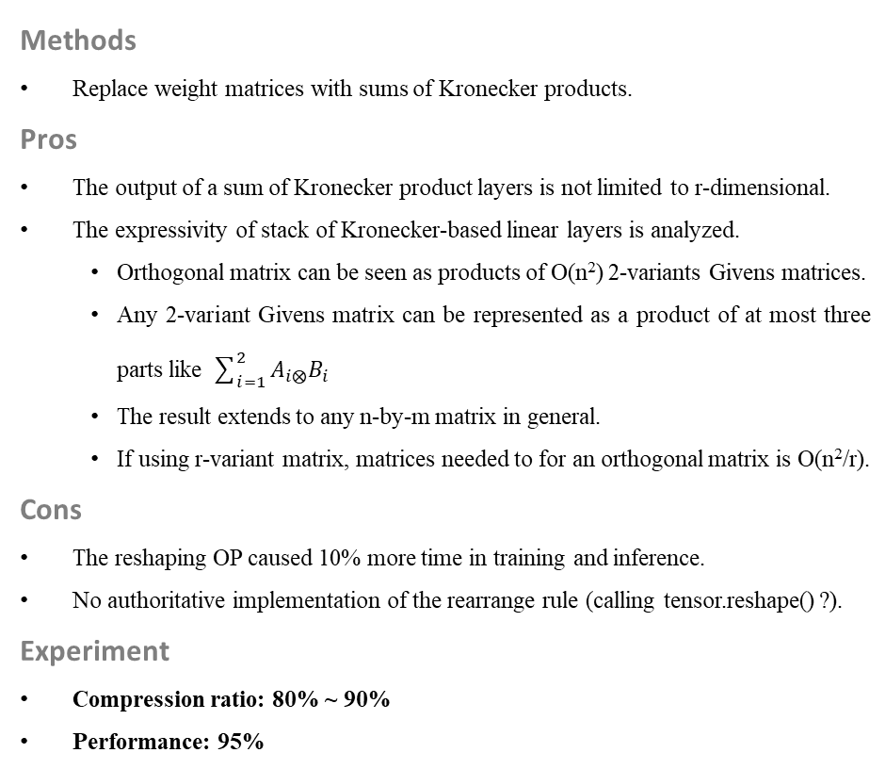
CPU设计
Shapeshifter
Methods
Replace weight matrices with sums of Kronecker products.
Pros
The output of a sum of Kronecker product layers is not limited to r-dimensional.
The expressivity of stack of Kronecker-based linear layers is analyzed.
Orthogonal matrix can be seen as products of O(n²) 2-variants Givens matrices.
Any 2-variant Givens matrix can be represented as a product of at most three parts like $\sum_{i=1}^{2}{A_{i⨂}B_{i}}$
The result extends to any n-by-m matrix in general.
If using r-variant matrix, matrices needed to for an orthogonal matrix is O(n²/r).
Cons
The reshaping OP caused 10% more time in training and inference.
No authoritative implementation of the rearrange rule (calling tensor.reshape() ?).
Experiment
Compression ratio: 80% ~ 90%
Performance: 95%
$$\sum_{i=1}^{r}{A_{i}×B_{i}}$$
$$\sum_{i=1}^{r}{W_{i}}$$
Shapeshifter: a Parameter-efficient Transformer using Factorized Reshaped Matrices (NeurIPS 2021)

Slide 6
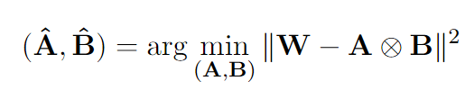
KnGPT2 &
TensorGPT
CPU设计
KnGPT2
Methods
Use Kronecker decomposition for compression of the GPT model.
Pros
Practice of Kronecker on decoder models.
Combine Kronecker with KD.
Cons
As an ACL findings, experiments and conclusions are not sufficient.
Different from Shapeshifter, it only takes matrix A and B to approximately represent W.
Experiment
Compression ratio: 33%
Performance: 95% w/o fine-tuning; 99% w/ fine-tuning.
TensorGPT
Methods
Treat token embeddings as matrix product states (Tensor train).
Pros
Flexible vocabulary and distribute-computation friendly.
Cons
To be explored on more structures of LLMs.
Experiment
Compression ratio: 20% (two-thirds of the embedding layer)
Performance: No ablation experiment.
Kronecker Decomposition for GPT Compression (ACL 2022 Findings)
TensorGPT: Efficient Compression of the Embedding Layer in LLMs based on the Tensor-Train Decomposition

Slide 7

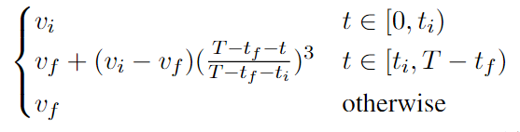
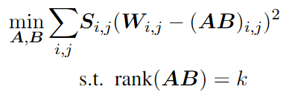

CPU设计
Step 1 : Unstructured Pruning
Importance score
Sparsity scheduler
At time t, the top-v_{t} parameters will be remained. V_{t} is calculated from the scheduler, where v_{i} is 1 and v_{f} is the expected percentage
LPAF
Methods
Combine FWSVD with Unstructured Pruning to compress PLM
Pros
UP makes matrices low-rank and friendly for SVD compression.
SVD compression enable the UP results to run on general devices.
Cons
The UP strategy is based on rows instead of elements.
Refine-tuning required.
Experiment
Compression ratio: 84%
Performance: 95%
Step 2 : Sparsity-aware SVD
Object
Sharing importance value：Same as FWSVD, assumption is made to obtain an approximate solution.
Step 3 : Mixed-rank fine-tune
Object
Fine-tuning includes both factorized and Pruned matrices, and z is sampled from distribution B(p) and p decays linearly.
Each input-x goes twice through the pipeline and the KL divergence is calculated as Loss func.
Low-Rank Prune-And-Factorize for Language Model Compression

Slide 8
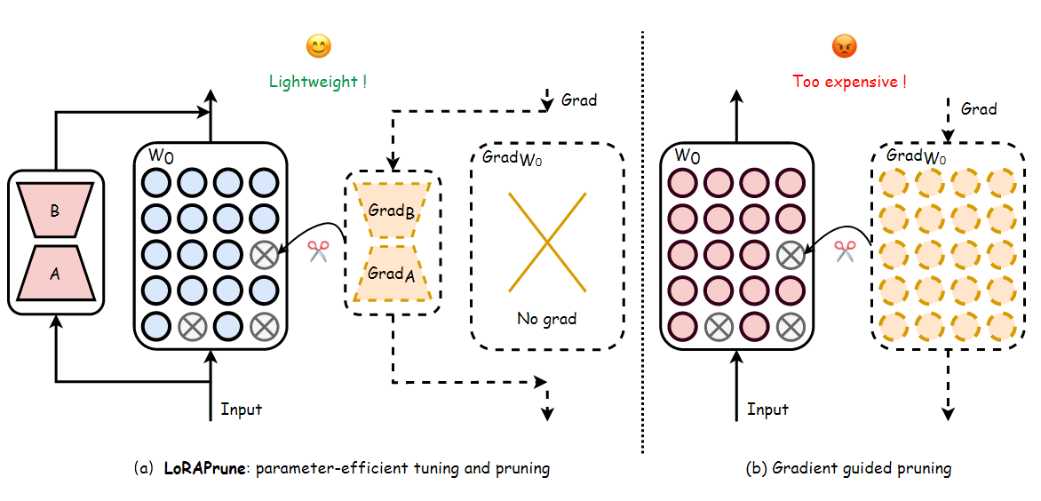
CPU设计
LoRAPrune
Methods
Use LoRA to instruct the UP process
Pros
Reduces computational resources required for pruning, as the gradients only need to be calculated for the parameters in the bypass
Cons
Backend support is required, like hardware or DL framework.
Experiment
Compression ratio: 90%
Performance: 90%
Pruning Meets Low-Rank Parameter-Efficient Fine-Tuning

Slide 9
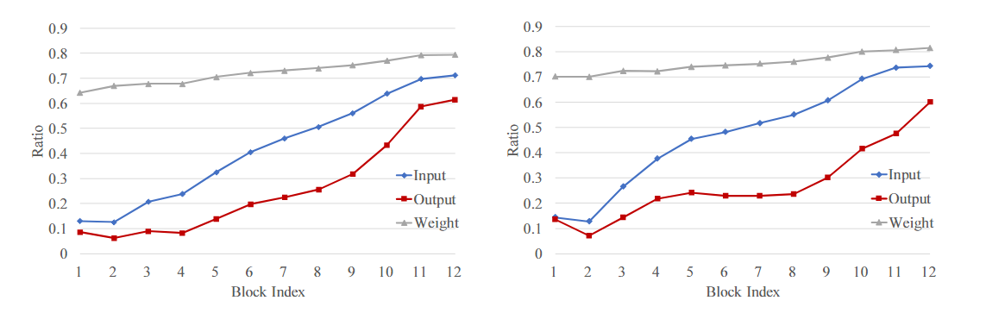
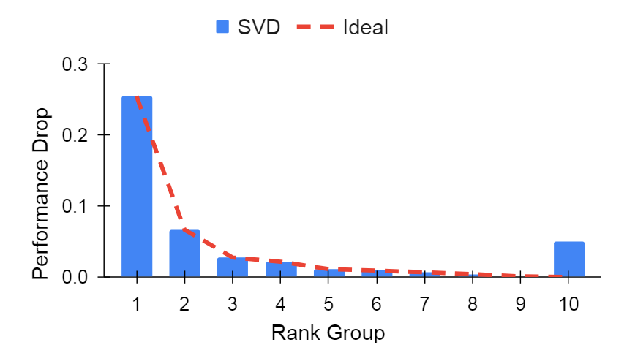
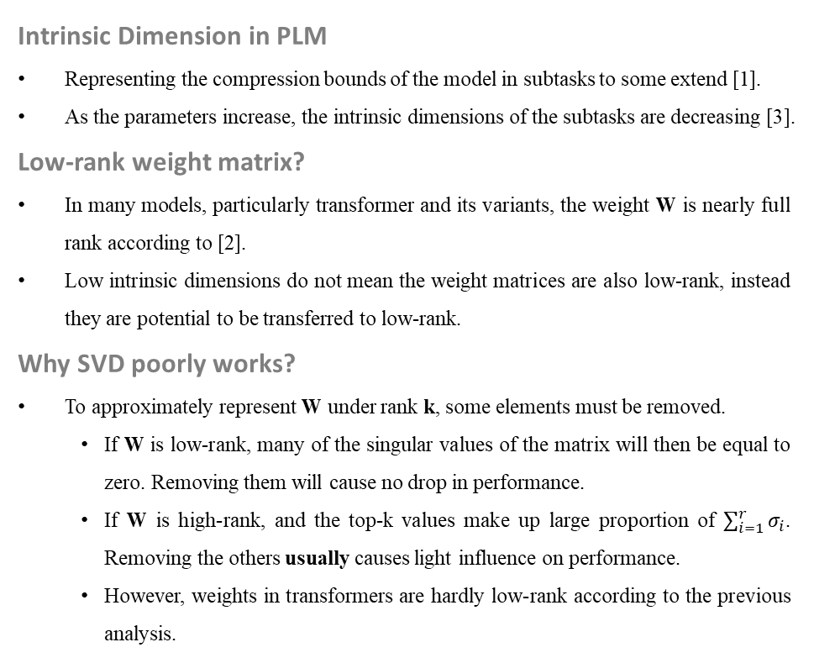
Intrinsic Dimension
CPU设计
Intrinsic Dimension in PLM
Representing the compression bounds of the model in subtasks to some extend [1].
As the parameters increase, the intrinsic dimensions of the subtasks are decreasing [3].
Low-rank weight matrix?
In many models, particularly transformer and its variants, the weight W is nearly full rank according to [2].
Low intrinsic dimensions do not mean the weight matrices are also low-rank, instead they are potential to be transferred to low-rank.
Why SVD poorly works?
To approximately represent W under rank k, some elements must be removed.
If W is low-rank, many of the singular values of the matrix will then be equal to zero. Removing them will cause no drop in performance.
If W is high-rank, and the top-k values make up large proportion of $\sum_{i=1}^{r}{σ_{i}}$. Removing the others usually causes light influence on performance.
However, weights in transformers are hardly low-rank according to the previous analysis.
Ratio of dimensions kept in each QKV (left) and FC1 (right) layer in DeiT-B when 90% energy is retained
The 1st group has the top 10% singular values, while the 10th group contains the smallest 10%
The truncation of the last group, which has the smallest singular values, is expected to behave following ideal
[1] Measuring the Intrinsic Dimension of Objective Landscapes (ICLR 2018)
[2] Compressing Transformers: Features Are Low-Rank, but Weights Are Not! (AAAI 2023)
[3] Intrinsic Dimensionality Explains the Effectiveness of Language Model Fine-Tuning (ACL 2021)

Slide 10
CPU设计
Future Work
Problem
Statistical features of LLM weight matrices
Rank
Variances
Sparsity
… ?
Will activations be influenced after compression?
Will operations target at subspace and intrinsic dimensions disable the emergent abilities of LLMs?
Refine-tuning is usually necessary for remaining performance, can it be improved ?
Idea
Analysis of matrices
For 2nd and 3rd, ablation experiments and further studies
Consider dynamic adapting algorithm like SparseGPT
SparseGPT: Massive Language Models Can Be Accurately Pruned in One-Shot

Slide 11
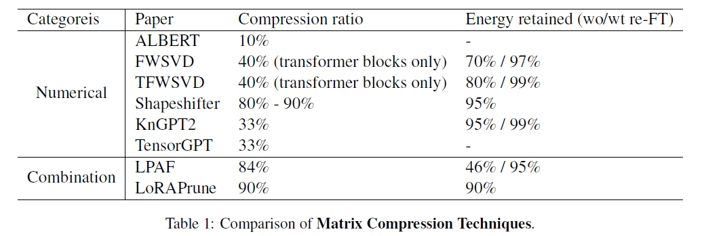
Motivation &
Challenge
CPU设计
To be improved
The vanilla SVD always caused significant decrease on performance.
Combining SVD with gradient information is as computational consuming as full fine-tuning(without updating steps), which is a huge cost for LLMs.
Refine-tuning is usually necessary for remaining performance.
Challenge
Few matrix factorization studies were done for LLMs, so the characteristics of parameter matrices stay unclear. Empirically, it should be like those of BERT series. But as a stack of decoders and trained in various domains, changes may be brought to them.
When the refine-tuning is conducted after weighted SVD on LLMs, it will cost as 2 times computational resource as full parameter fine-tuning. It seems lavish compared with methods like pruning or quantization.
Most methods in the left sheet didn’t provide code implementations.
How to efficiently compress LLMs by matrix compression without fine-tuning?

Slide 12

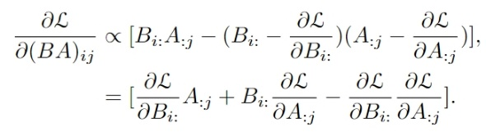
Timeline
CPU设计
Method
Step 0 : Analysis of matrices
Sample from the LLMs and analysis the numerical characteristics of matrices
Step 1 : Weighted SVD Implementation
Considering the optimal objection in FWSVD
To simplify the problem, we follow the assumptions in FWSVD: the importance is row-wise instead of element-wise
Apply it on the LLM baseline
Method
Combination of SVD and gradient information does work well but is computational demanding when adapted to LLMs. Thus, consider including LoRA for measuring parameters importance, inspired from LoRAPrune.
Refine-tuning may be necessary but must be expensive when scaling SVD methods from BERT to LLMs. Since we have already introduced LoRA, why not using it as dynamic compensation when doing factorization. In this way, matrix factorization and refine-tuning can be performed simultaneously.
When applying the second part, it will cause increase in memory and time utilization as the full gradient is required for LoRA fine-tuning. Nevertheless, ideally, we can obtain a lightweight model that is 10%-param of the original model with the computational cost similar to PEFT.
To achieve higher compression ratio, we may conduct further experiments like QLoRA… Or we can even set the baseline at FP16 since LLMs are not sensitive to data-width.
Step 2 : LoRA weighted strategy
Change the importance measuring strategy in FWSVD to the presentation of LoRA
Step 3 : Utilize LoRA as compensation
Take the LoRA updated in step 2 as the refine-tuning result for SVD factorization
Whether or not doing this will depend on the performance after the previous steps.
Step 4 : Further experiments
Change the importance measuring strategy in FWSVD to the presentation of LoRA

Slide 13
Compression
of LLMs
CPU设计
Methods | Quantization🔥 |  | Knowledge Distillation | Pruning |  | Low-rank approximation
 | PTQ | Data Aware Quantization | KD | Structured | Unstructured🔥 | unknown
Paper | Widely used in industry | AWQ [1] (MIT, SJTU, THU) | MINILLM [2] (CoAI, THU) | LLMPruner [3] (NUS) | SparseGPT [4] | unknown
Compression ratio | 50% (fp32->fp16) | 90% (fp32->int4) | 50% | 20% | 50~60% | unknown
Speedup | Little more than 2x (use fp16 for inference) | 1.5x (compared with fp16) | Not mentioned | Not mentioned | Supports are essential from framework and hardware | unknown
Performance | Little influence, can be ignored. | Nearly the same as fp16 on PPL | 2~3 points drop of feedback from GPT4 | 10% drop on zero-shot | Little drop on some few-shot tasks | unknown
Note | Widely used in industry | Practical performance remains testing |  | Inexpertly obtain increase on some tasks |  | unknown
[1] AWQ: Activation-aware Weight Quantization for LLM Compression and Acceleration
[2] Knowledge Distillation of Large Language Models
[3] LLM-Pruner: On the Structural Pruning of Large Language Models
[4] SparseGPT: Massive Language Models Can Be Accurately Pruned in One-Shot

Slide 14
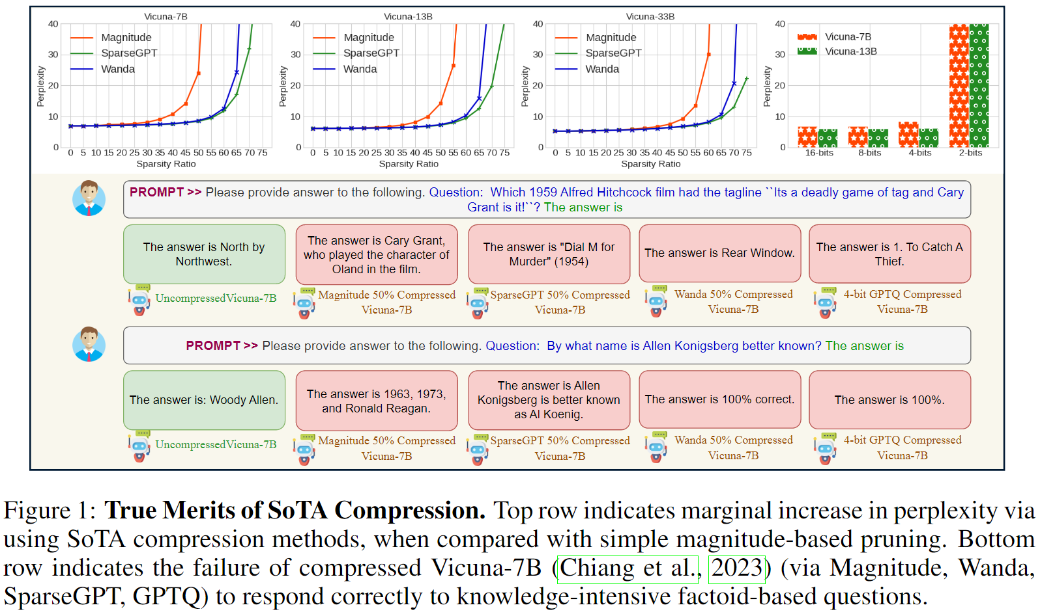
Compression
of LLMs
CPU设计
Suitable metrics
How to evaluate the performance after compression:
Many works claim that they achieved high compression ratios with little increase in PPL (reflecting the Language Modeling capacity).
Is that sensible? In fact, what we concern about is the emergent abilities like LM, CoT, ICT, QA, etc.
A recent work from University of Texas at Austin and Apple proposed a Knowledge intensive benchmark and find:
Despite negligible changes in ppl, pruning can cause failing in knowledge-intensive task.
Current quantization methods are better at maintaining performance in comparison to sota pruning methods.
Compressing LLMs: The Truth is Rarely Pure and Never Simple

Slide 15
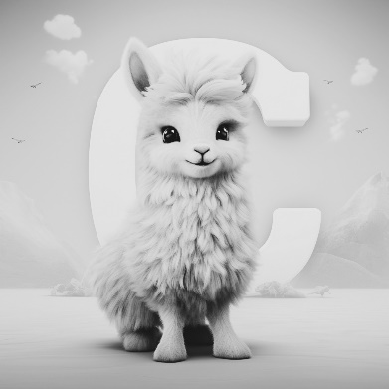
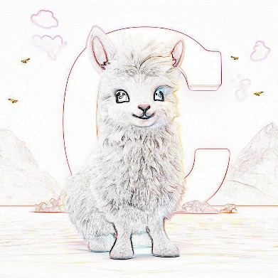





Low-rank Approximation
CPU设计
Quantization
Advantages of low-rank approximation
Has been proved to work in PEFT: LoRA.
Theoretically, features are approximately presented like the well working methods: quantization and UP.
More general compared with KD, which is sensitive to hyperparameter choices and training tricks.
Overcome the weakness of UP and low-bit quantization which require supports from framework and hardware.
Comparing with medium models (<1B), the large one may care less about those noise produced after approximation.
How to remain more knowledge:
llama, “C”, clouds, mountains
Unstructured Pruning
512
Structured Pruning & KD
1024
Low-rank Approximation

Slide 16
CPU设计
How SVD Works
SVD Algorithm
Decompose the Weight matrix into three sub matrices.
Select k rank to represent it approximately.
Separate the original Linear module into two, initialized by ∑V and U.
Re-finetune the model on certain domain.

Slide 17
How to select k
Information from Gradient
Improve the accurate by Fisher information in FWSVD.
Align the optimization objective of compression with the model, rather than just minimizing reconstruction error (Frobenius norm).
Still need re-finetune on BERT series.
Vanilla SVD
Fisher-Weighted SVD
Language model compression with weighted low-rank factorization (2022 ICLR)
Numerical Optimizations for Weighted Low-rank Estimation on Language Model (ACL 2022)

Slide 18
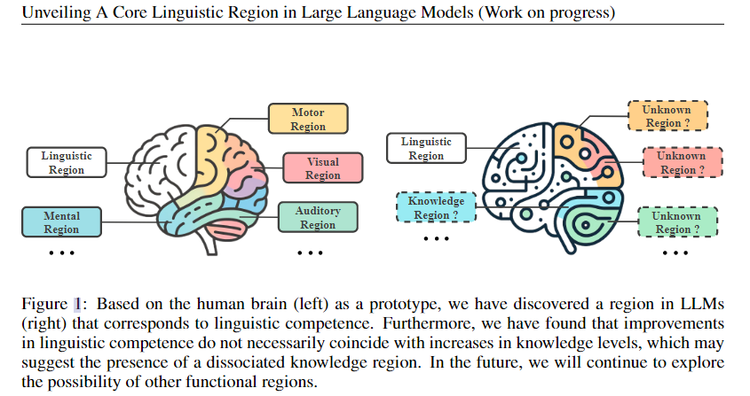
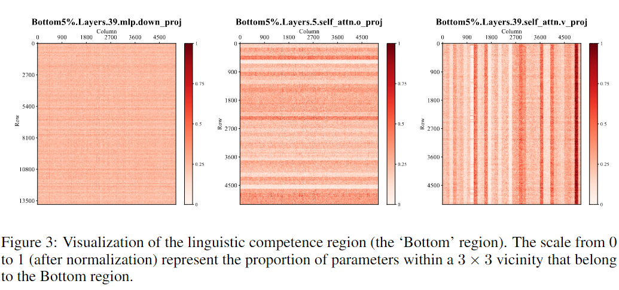
Low Rank for LLMs
Important Results
About 1% parameters are crucial for Language Modeling.
Most knowledge is saved in the FFN modules.
Possible functional partitioning of different parameters of an LLM.
Unveiling A Core Linguistic Region in Large Language Models (CLR)

Slide 19
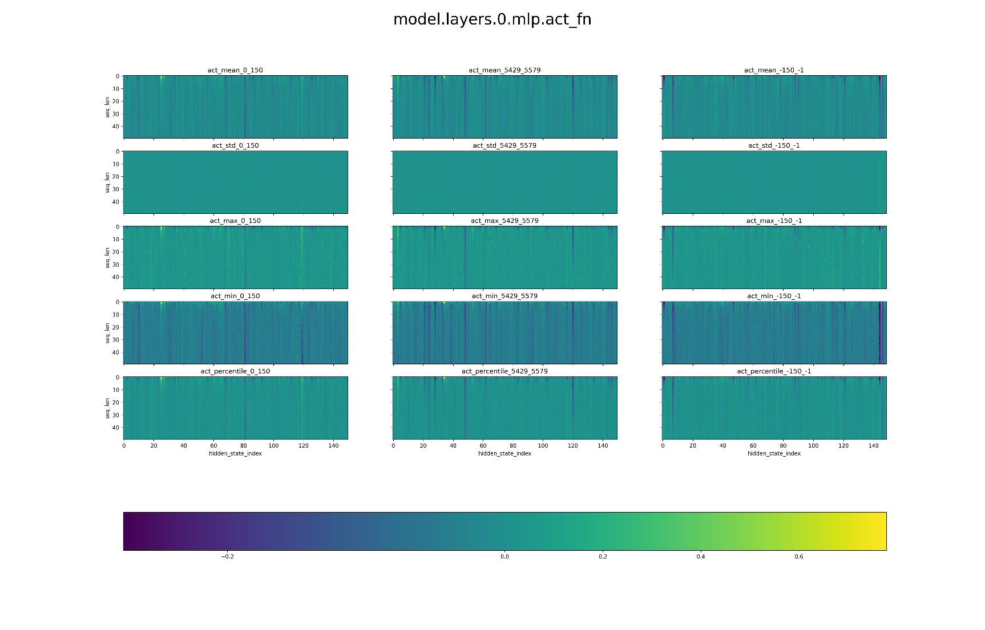
Current Results
Our experiments
Both feature maps and gradients exhibit low-rank properties.
Throughput can be increased by approximation alone (the post tokens can be represented by a single token).
Salient parameter values ​​are observed, consistent with the conclusions of AWQ and CLR

Slide 20
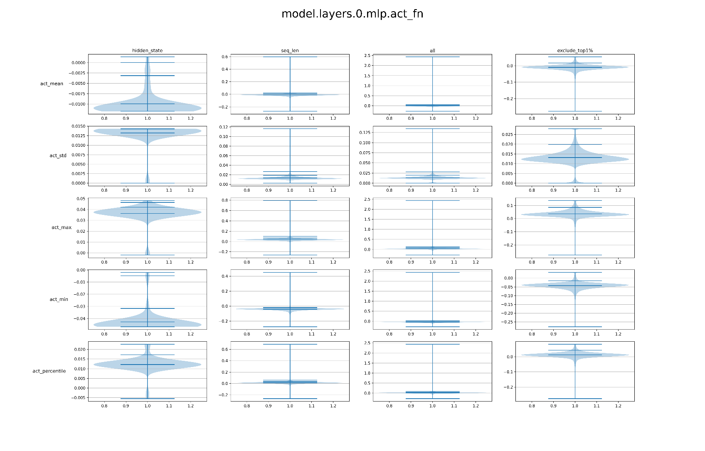
Current Results
Our experiments
Both feature maps and gradients exhibit low-rank properties.
Throughput can be increased by approximation alone (the post tokens can be represented by a single token).
Salient parameter values ​​are observed, consistent with the conclusions of AWQ and CLR.

Slide 21




CPU设计
Method
Language Modeling: as a downstream task
LoRA: PEFT for certain task or dataset.
Low rank features show during finetuning: efficient
Language modeling is Low-rank friendly:
PLM of medium size: FWSVD, LPAF, factorization then re-finetune
CLR: function region, distributed in rows or columns
Low rank compression:
LoRA + SVD + Distillation tricks
Decompose W to A and B
Init A and B with SVD results
Let W gradually return to zero and tune A B to compensate for it
Evaluation:
Wikitext -> PPL
MMLU
C4 (more GPU)
PEFT: base + task specific params
Add LoRA to the original params
LM = base – unrelated params
LM is a downstream task
Take W as the start
Learn to leave W step by step

Slide 22
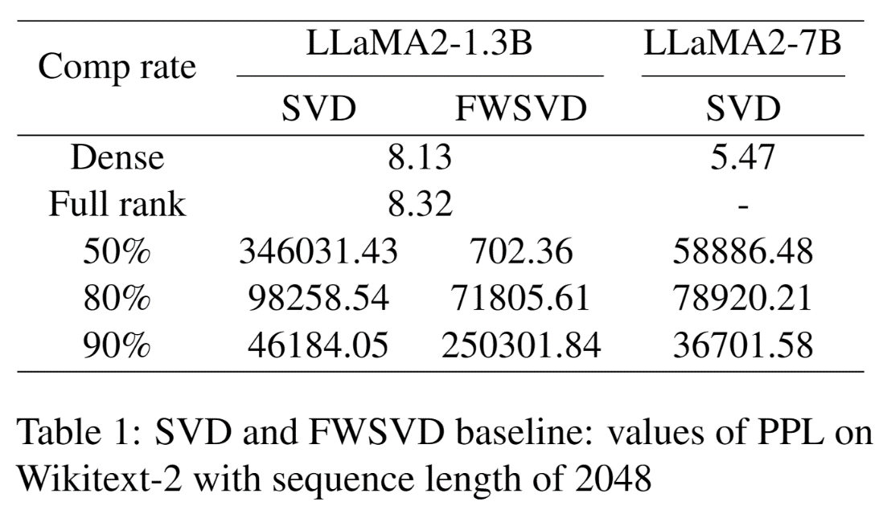
Baseline
LLaMA2
Wikitext: PPL
Sequence length = 2048
torch.svd_lowrank
Fp16 inference
Computational Efficiency
Hard to obtain fisher information
Forward + backward: 7B half model -> 30GB+ memory footprint
Well pre-trained model, small gradient values, some salient ones
Fp32 is necessary for gradient storage

Slide 23
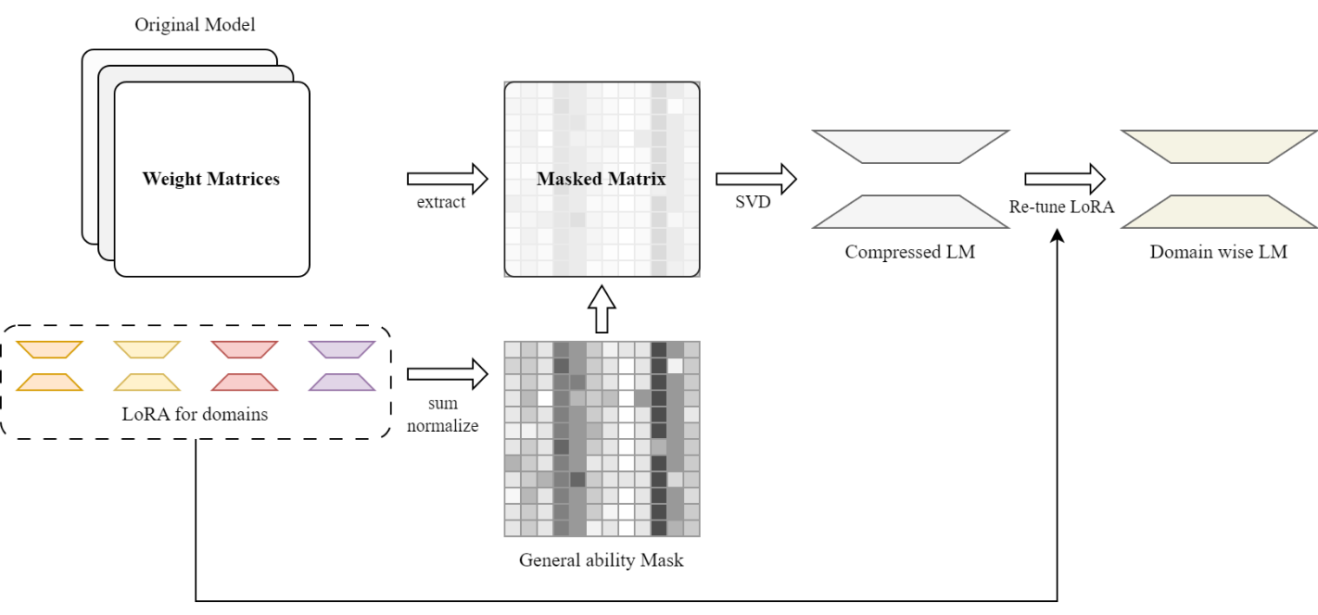
Findings
Fine-grained Importance Evaluation
FWSVD, LPAF: larger gradient on downstream dataset -> to be remained
But we need a general base model
Directly multiplying importance with weights leads to re-finetuning
CLR: elements with less variants during multi-domain finetuning are important
Core language region -> general ability of language modeling

Slide 24
Methods | Quantization🔥 |  | Knowledge Distillation | Pruning |  | Low-rank approximation
 | PTQ | Data Aware Quantization | KD | Structured | Unstructured🔥 | unknown
Paper | Widely used in industry | AWQ (MIT, SJTU, THU) | MINILLM (CoAI, THU) | LLMPruner (NUS) | SparseGPT | unknown
Compression ratio | 50% (fp32->fp16) | 90% (fp32->int4) | 50% | 20% | 50~60% | unknown
Speedup | Little more than 2x (use fp16 for inference) | 1.5x (compared with fp16) | Not mentioned | Not mentioned | Supports are essential from framework and hardware | unknown
Performance | Little influence, can be ignored. | Nearly the same as fp16 on PPL | 2~3 points drop of feedback from GPT4 | 10% drop on zero-shot | Little drop on some few-shot tasks | unknown
Note | Widely used in industry | Practical performance remains testing |  | Unexpectly obtain increase on some tasks |  | unknown

Slide 25
“
Q&A
”
Thanks for your time

